Slide 1
TriBUTE BANDS AND TRIBUTE CALCULATORS

Slide 2
TriBUTE BANDS AND TRIBUTE CALCULATORS
Tribute acts and bands:
Elvis emulators
Beatles copiers
Abba duplicators

Slide 3
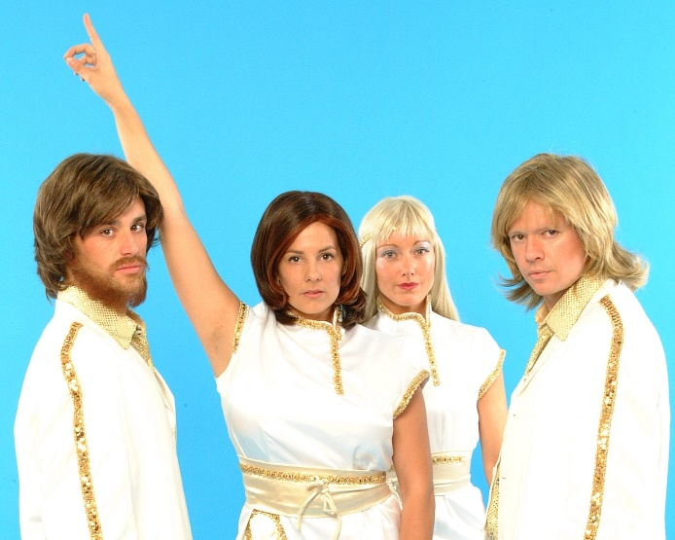
TriBUTE BANDS AND TRIBUTE CALCULATORS
Tribute acts and bands:
Elvis emulators
Beatles copiers
Abba duplicators
And so on…

Slide 4
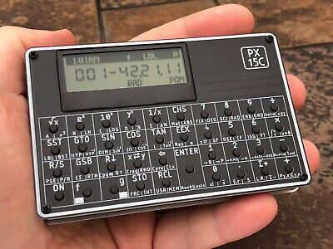
TriBUTE BANDS AND TRIBUTE CALCULATORS
Tribute acts and bands:
Elvis emulators
Beatles copiers
Abba duplicators
And so on…
Tribute calculators:
HP: HP-27S, HP35S, HP-15C LE
Swiss Micros: HP-15C copy and more
Alexgarza: in Mexico selling self-assembly Voyager copy kits
And more to come...

Slide 5
TriBUTE PRESENTATION
Tribute to Bob Prosperi:
Gave this presentation at HHC 2022
Cannot be with us here
So I am giving his talk, with my additions
Thank you Bob
Tribute to Swiss Micros:
Have created a whole range of HP-work-alike calculators
Have allowed Bob, and now me, to present the DM32
Michael Steinmann is here with us
Thank you Michael and David

Slide 6
When Odran is New Again
HHC Nashville Sept 10-11, 2022

Slide 7
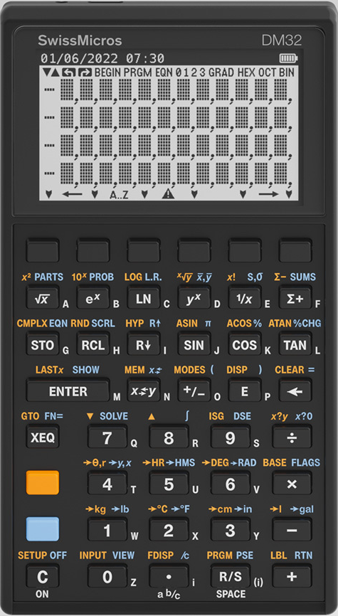
Preview of Swissmicros’ DM32
DM32 is:
A fully compatible clone of HP-32SII
Built on DMCP (DM Calculator Platform)
Enhanced to leverage DMCP’s superior screen, tactile keyboard, I/O, and other family features
DM32 is not:
Emulated! It is not running an HP ROM, this is 100% original DM C code
As slow as a 32SII
As memory-limited as a 32SII

Slide 8
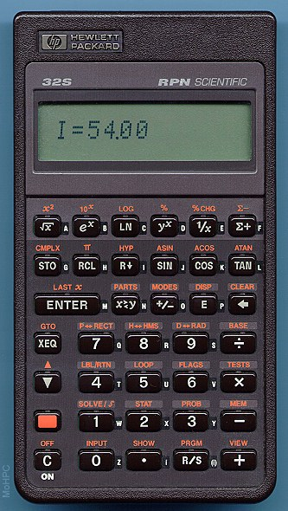
Introduction to the HP-32
The original HP-32S
One of the Pioneer family
This included the algebraic HP-20S, the stat/math HP-21S and the equation handling HP-22S
The HP-32S was the low-end RPN model simple display, one shift key
There were more models, including the HP-42S, already copied by the DM-42
The HP-32SII
An HP-32S extension including fractions, and equations copied from the HP-22S

Slide 9
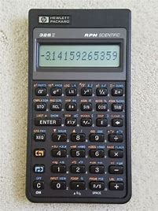
Introduction to the HP-32
Two shift keys, two colour versions
My involvement
I wrote a guide to the HP-32S
HP-32SII beta tester
The HP-32S II developers invited me to discuss their plans for the new model with them in Corvallis
We agreed that squeezing in fractions mode, equation entry mode and conversions were more important than a polynomial solver

Slide 10
BACK TO Preview of Swissmicros’ DM32
DM32 is:
A fully compatible clone of HP-32SII
Built on DMCP (DM Calculator Platform)
Enhanced to leverage DMCP’s superior screen, tactile keyboard, I/O, and other family features
DM32 is not:
Emulated! It is not running an HP ROM, this is 100% original DM C code
As slow as a 32SII
As memory-limited as a 32SII

Slide 11
Why COPY the HP-32Sii?
Goal: Simpler and more accessible RPN model
Full set of Math Functions, Solve, Integration
Easy to learn and use programing model
Algebraic Equations (incl. Solve), Fractions
Handy unit conversions and binary math
Users needing advanced complex, matrix, etc. => DM42
Other candidates:
20S, 21S, 22S, (or other Pioneers) – Algebraic? Uh… no!
33S – Keyboard from Hell. Need anything else be said?
35S – Bugs, keyboard, poor LCD limited popularity
What are 32SII’s most annoying features/limits???

Slide 12
DM32 is already a VIDEO STAR
https://youtu.be/HPAwQXcJUj0
Thanks to Logan West for this great video!

Slide 13
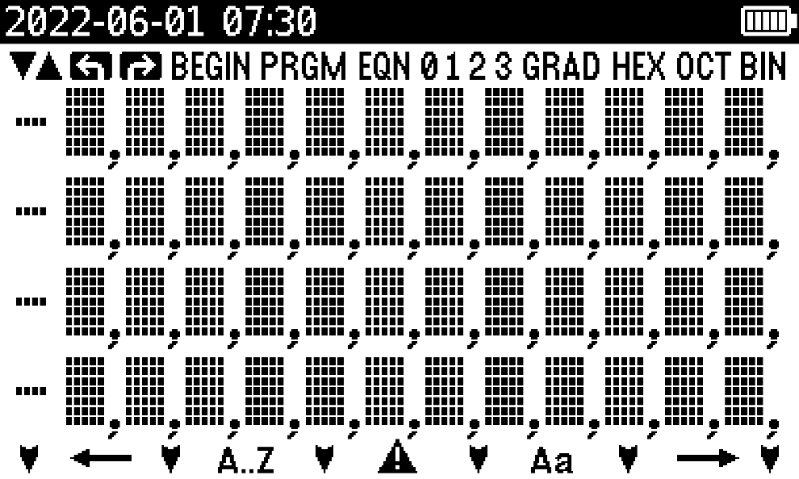
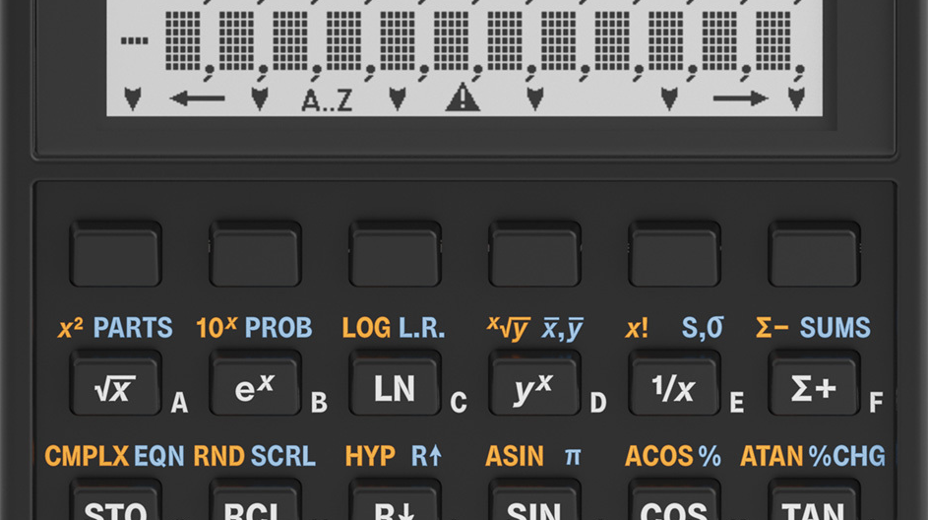
DM32 Built on DMCP
Proven Tactile Keyboard
99.9% same 32SII layout
Orig (blue/yellow) scheme
Extra key row at top
400 x 240 LCD
High contrast, always-on
View all 4 stack levels
All original annunciators
Clock and Batt Status

Slide 14
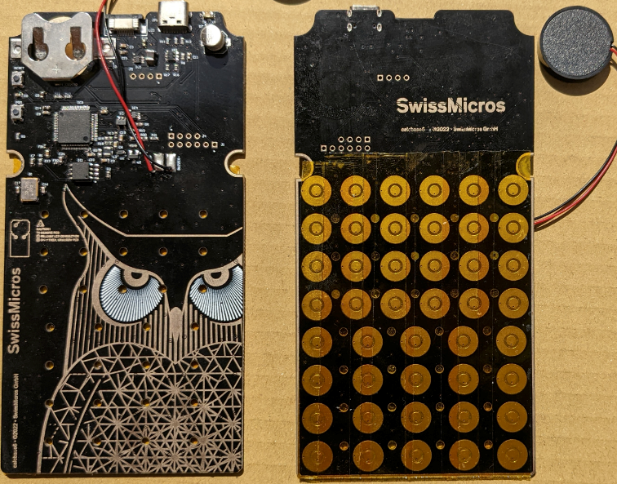
DM32 Built on DMCP
New SOC platform - STM32U575RIT6Q
2MB Flash / 768KB RAM
8MB QSPI Flash (1.5 MB Intel FP Lib & 6MB FAT)
>> 256KB RAM for appl.
USB-C Connector (USB 2.0)
40 nm and SMPS step-down vs. 90 nm w/o SMPS on prior (higher efficiency, low power)
Approximately 2x cur. speed
May achieve same speed on Batt as current h/w on USB…

Slide 15
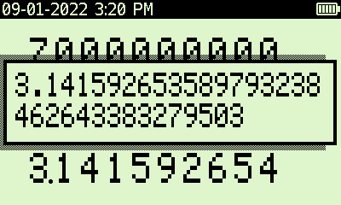
DM32 Functional EnhaNcements
Utilizes Intel FP Library
34-digit precision
Enhanced SHOW
Far larger RAM (> 680x !) requires more Globals to be used effectively
Currently exploring options to double Global Labels and Global Vars while preserving 32SII model and feel
Considering local labels for initial release (e.g. LBL 01)
Requires change to program model (currently 1 large space)
Function Preview and Cancel (press/hold)
Same as 41C and 42S – Long-press to cancel

Slide 16
DM32 Functional Enhancements
Customizable Fn Function Keys on Top Row
Default assignments for F1..F6
F1-Help, F2-PRGM, F3-FDISP, F4-EQN, F5-UP, F6-DOWN (tentative)
Can also be re-assigned as 1-key program launchers
Example: Pressing F3 is equivalent to “[XEQ] [T]” to access fav/frequent programs; saves a key and no hunting for specific letters
Configured via utility in Setup Menu
DMCP Flagship Family Features
Capture LCD screen shots (.bmp files in /SCREENS on FAT)
USB Drive Drag-n-Drop FAT file access (state, screens, help, etc.)
Off-Screen image displayed when off (uses zero power)
Built-in Help Content
DM32-specific features
High-Level Descriptions for many (non-trivial) Functions
Complete listing of all Functions, including keys to invoke

Slide 17
Dm32 State File
# STACK
SY: 3
SZ: 3
ST: 2
SL: -0.3420201433256687330440996146822601
# REGS
Ri: 34 # Indirect Register
RD: 55
RL: 17
RP: 3.141592653589793238462643383279503 #Pi
RV: 40389.10055271377932198535899628711
RZ: 99599
# FLAGS
# MODE
MTRIG: DEG
MFMT: FIX 2
# EQUATION LIST
EQNPTR: 1
EQN
V = 0.25 \mul; \pi; \mul; D ^ 2 \mul; L # Vol
R = 2 \mul; C \mul; COS( T - A )
EQNEND
# PROGRAM
PTR: 0
PGM
LBL T # %T
1/x
%
1/x
RTN
PGMEND
Stores user data / config. settings
Stack, Variables, Flags, Modes, Equations, Programs
Simple, easy-to-grasp text basis
Maintain multiple state files and swap between them with 6-7 keystrokes
Import/Export files via FAT (USB)
Share state files with other users
Allows easy program entry, creating program listings on PC/Mac/Phone
Comments (discard chars after # )
Import truncated upon invalid content
(But obvious potential to explore synthetics…)

Slide 18
How does the Dm32 Compare?
How Compatible is the DM32?
Will run existing 32SII programs unchanged
Different results not uncommon due to precision
Checksum/Prog. Length not needed/implemented
How fast is the DM32? (Cur. h/w)
Empty loop – 65x (Batt), 150x (USB)
Prime Factoring* (from MoHPC) for 111111113:
32SII – 3 Min, 39 Sec
DM32 – 1.5 Sec
HP-15C --> 302
HP-41CX --> 1,015
HP 32SII --> 4,710
HP 33s --> 10,124
HP 35s --> 3,682
DM32 on batt --> 308,664
DM32 on USB --> 743,228
* Thanks Joe

Slide 19
Thanks to…
Michael – for passion and demanding quality
David – for all the magic, and much patience
Emy – for improved graphics, help and docs
Joe, Gene, Jake, Wlodek & Logan - Testing
Joe – Again! For some extraordinary* testing
HP – For the 32SII, and all the rest…
* Ex: “Bug in v1.56: When any Shift key is pressed, the current FDISP accuracy indicator gets replaced with one based on the T register.”

Slide 20
BOB’s AD-HOC market research…
Which other models should be considered for future DMCP products, and why?
Demand for DM48 is well understood
Consider semi-clones, which may adjust some features of a desirable model
Example: I’d like a DM27, which is a 27S functional clone that swaps Algebraic for RPN
Wlodek – hear, hear! There is already an HP-27SII built into the HP200LX palmtop

Slide 21
And finally….
Thank you Bob, thank you again Swiss Micros

